Slide 1

Mobile Application for Young Mother
Author: Repina Anastasia, BSE143
Higher School of Economics, Moscow, 2018
www.hse.ru

Slide 2
Agenda
Related work
Survey
Application architecture and design
Technologies

Slide 3
Related Work
Application name | Price (₽) | Baby’s health monitoring | Mother’s health monitoring | Data analysis | Wearable data collection | Stability | Timetable
Health Kit | free | - | + | + | + | + | -
Baby diary | free | + | - | - | - | + | +
Baby Connect | 159 | + | - | + | - | + | +
Ya rodilsya | 149 | + | - | + | - | + | +
FirstYear | free | + | - | + | - | +/- | +
Mi Fit | free | - | + | + | + | - | -
This work | free | + | + | + | + | + | +
Notes:
В рамках подготовительной работы очень важным этапом является анализ существующих решений.
Ни одно из исследованных приложений не решает все задачи сразу, что говорит о том, что проблема существует и ее можно решить способом, который предлагаю я

Slide 4
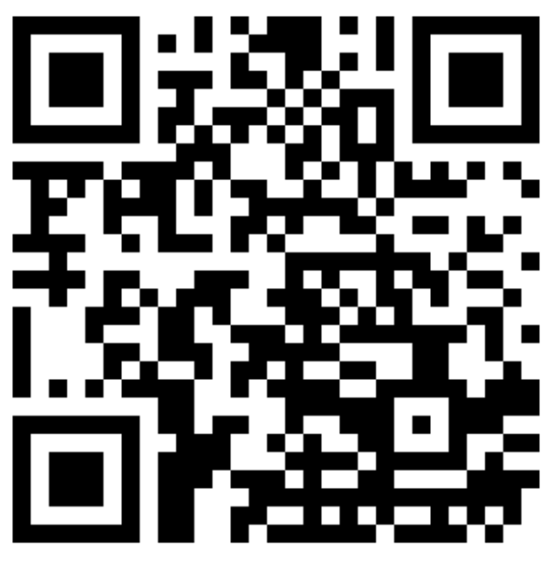
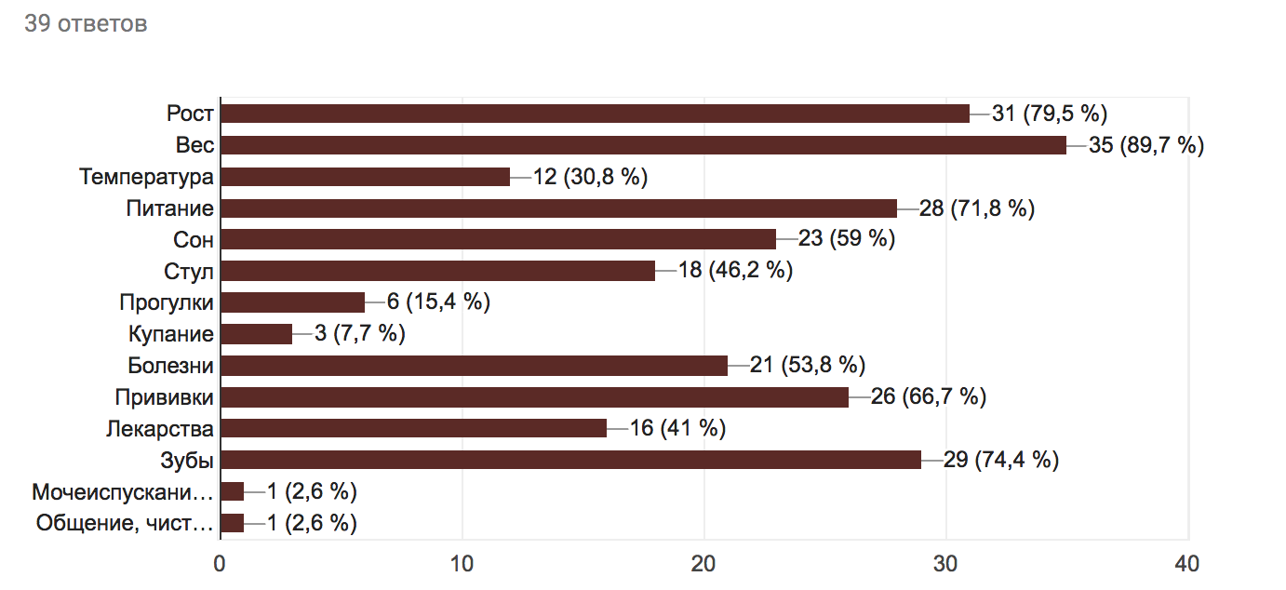
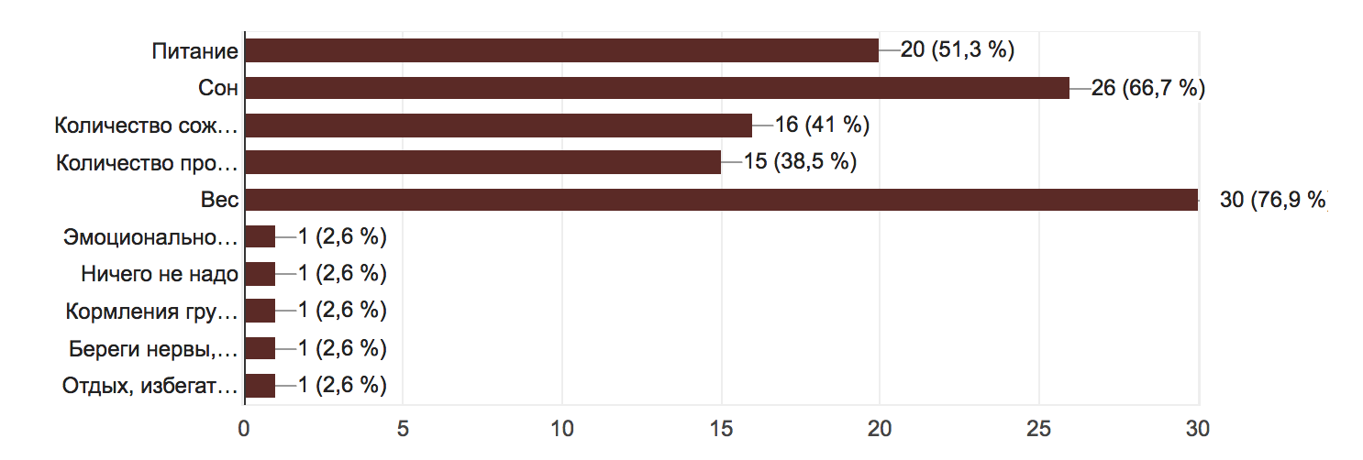
Survey
Baby
Young mother

Slide 5
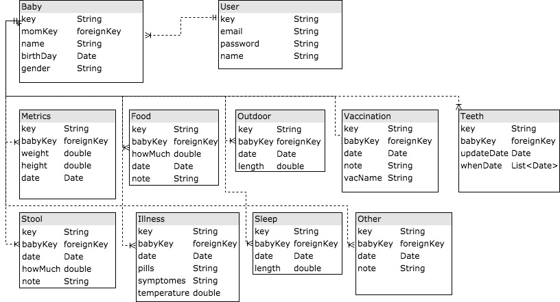
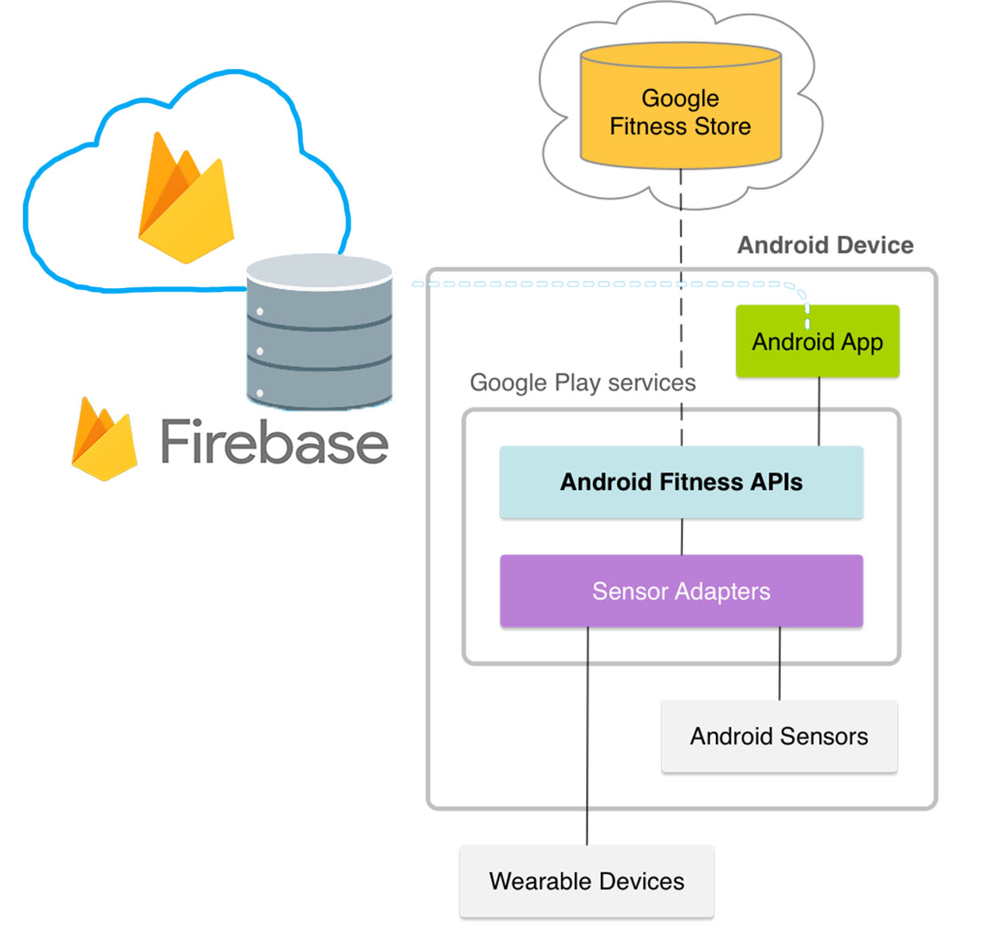

Application architecture and design
Manual input

Slide 6

Technologies

Slide 7
Summary
Android application
Functions for both: mother and baby
Google Fit, Google Firebase, MPAndroidChart

Slide 8
References
C. Kratzke, C. Cox. Global Journal of Health Education and Promotion, vol. 15, pp. 72-82, 2012.
E. Derbyshire, D. Dancey. “Smartphone Medical Applications for Women’s Health: What Is the Evidence-Base and Feedback?”. International Journal of Telemedicine and Applications, vol. 2013, Article ID 782074, 2013.
Google Inc., “Health-tracking platform.” Internet: https://www.google.ru/intl/en_en/fit/, [Jan. 5, 2018].
V. Gay, P. Leijdekkers. “Bringing Health and Fitness Data Together for Connected Health Care: Mobile Apps as Enablers of Interoperability”. J Med Internet Res, vol. 17, p. 260, 2015.
Apple Inc., “Health informatics mobile application.” Internet: https://www.apple.com/ru/ios/health/, [Jan. 5, 2018].
BabyJoyApp, “Child’s growth and development mobile application.” Internet: https://play.google.com/store/apps/details?id=com.babyjoy.android, [Jan. 5, 2018].
Seacloud Software, “Child’s growth and development mobile application.” Internet: https://play.google.com/store/apps/details?id=com.seacloud.bc, [Jan. 5, 2018].
S. Nikitin, “Child’s growth and development mobile application.” Internet: https://itunes.apple.com/ru/app/a-rodilsa/id477391124?l=en&mt=8, [Jan. 5, 2018].
Y. Ding, “Child’s growth and development mobile application.” Internet: https://itunes.apple.com/ru/app/firstyear-baby-feeding-timer-sleep-nappie-log/id645810513?l=en&mt=8, [Jan. 5, 2018].
Anhui Huami Information Technology Co. Ltd., “Health informatics mobile application.” Internet: https://play.google.com/store/apps/details?id=com.xiaomi.hm.health, [Jan. 5, 2018].
IDC Corporate USA, “Worldwide Quarterly Mobile Phone Tracker”, Internet: https://www.idc.com/tracker/showproductinfo.jsp?prod_id=37, [Jan. 12, 2018].
Google Inc., “Mobile and web application development platform.” Internet: https://firebase.google.com/, [Jan. 5, 2018].
(2010, Sep. 9). “J&J Launches Aid Program for Mothers.” Reuters. [On- line]. Available: http://www.reuters.com74/article/2010/09/09/us-jj-aid-program-idUSTRE6883ID20100909 [Dec. 1, 2017].

Slide 9
Thank you
Author: Repina Anastasia, BSE143
Higher School of Economics, Moscow, 2018
www.hse.ru

